Slide 1
Predicting Content Change on the Web
Kira Radinsky
Technion, Israel
Paul Bennettt
Microsoft Research

Slide 2
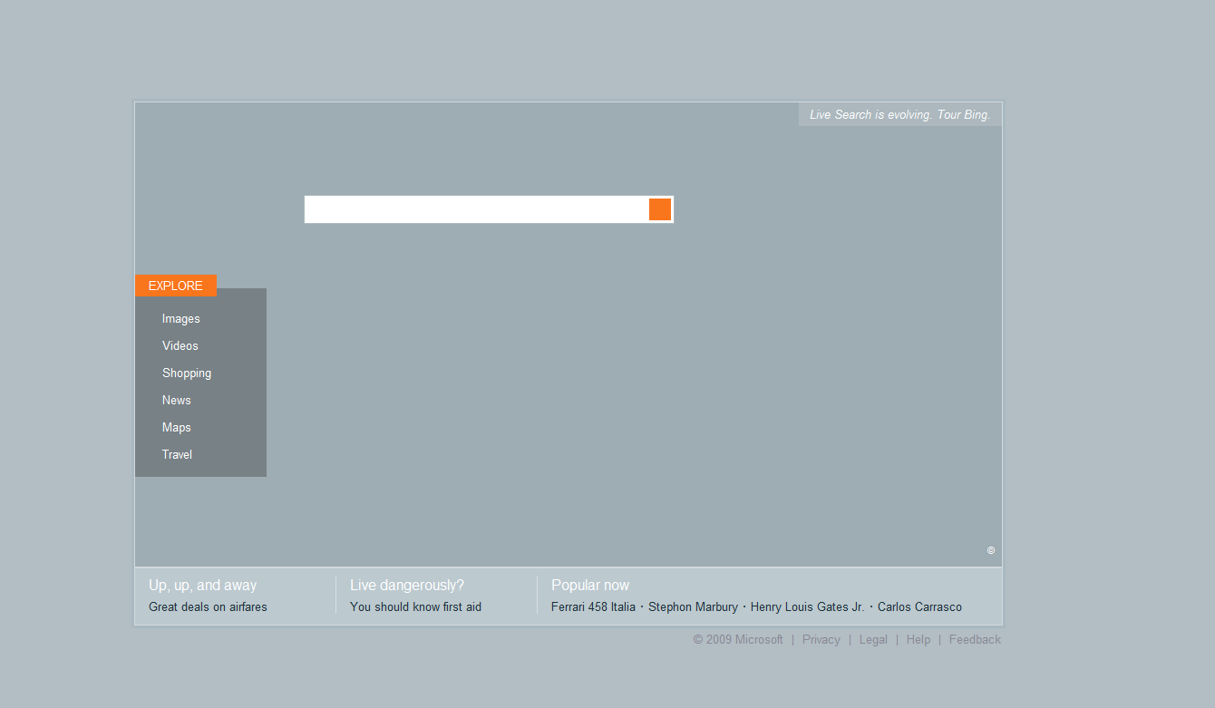
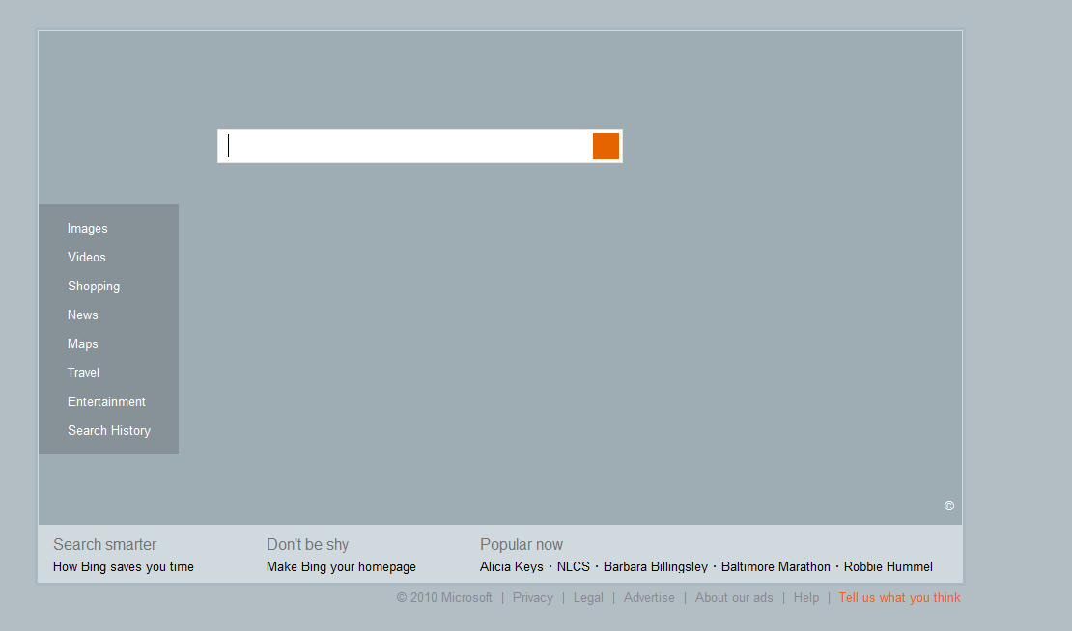
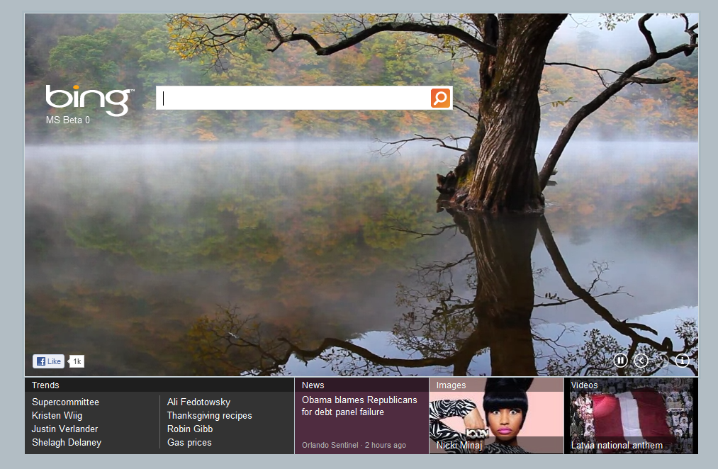
2009
2010
2011
Bing Site
Notes:
33% of Web pages change
66% of visited Web pages change
63% of these change every hr.

Slide 3
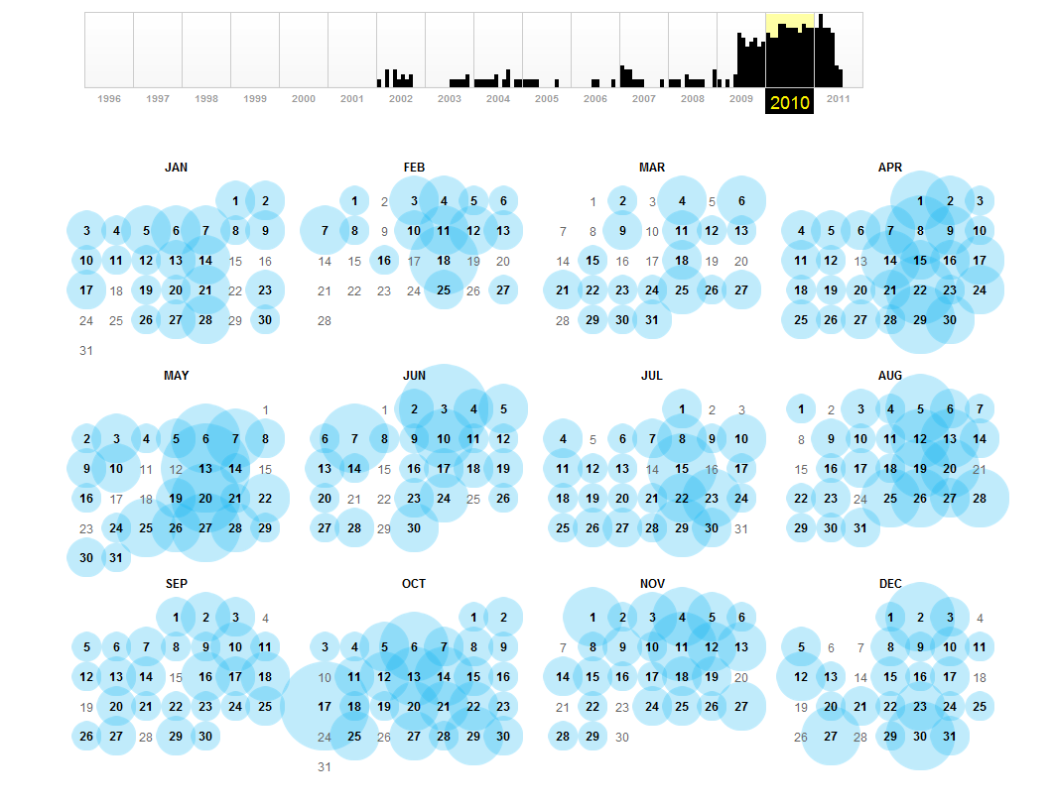

Slide 4
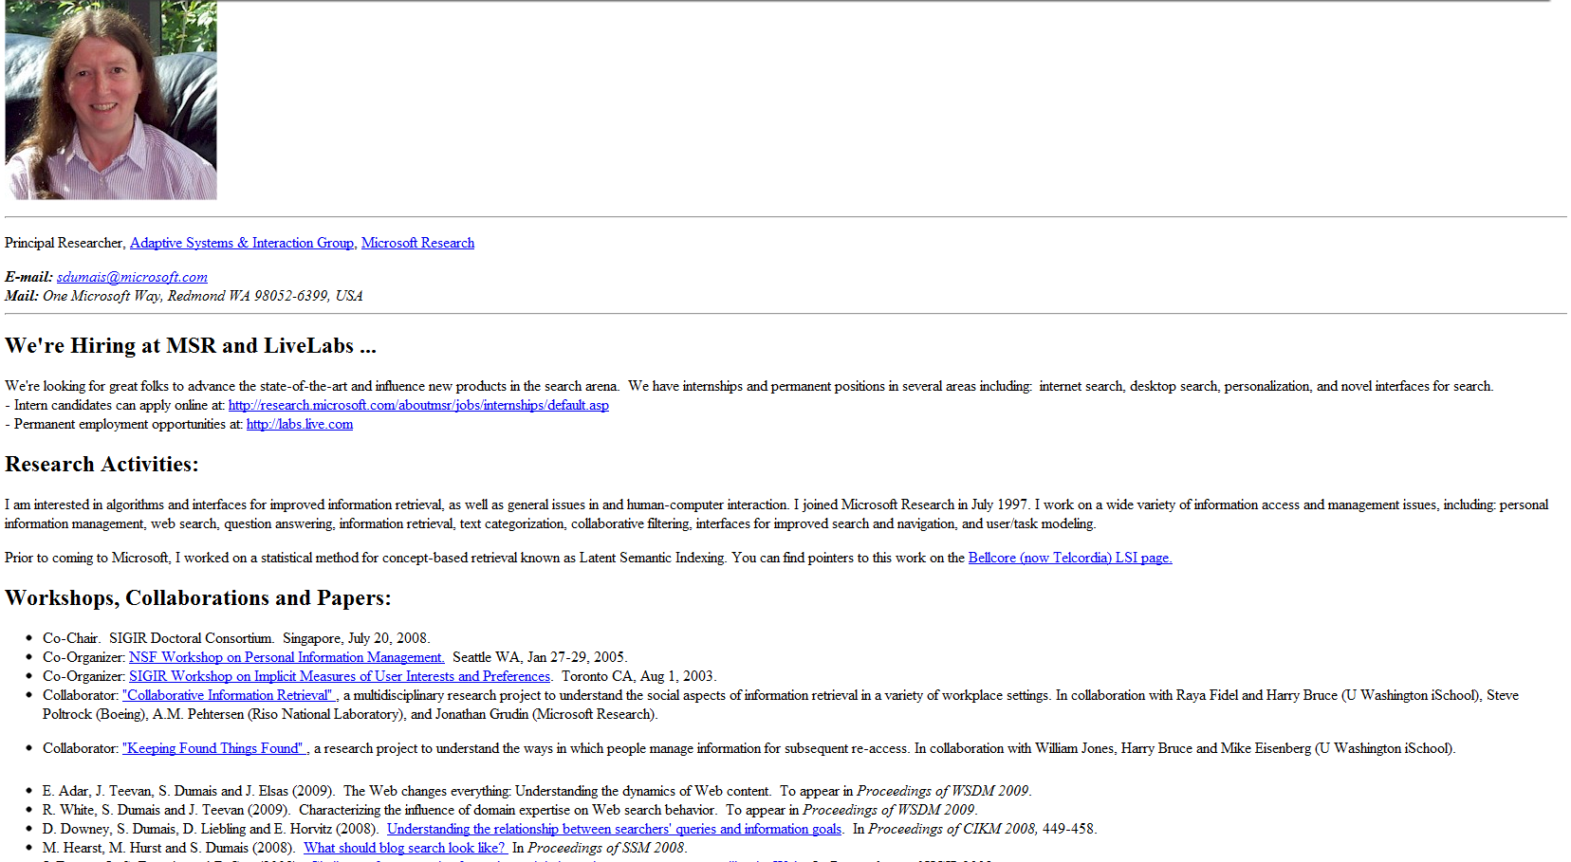
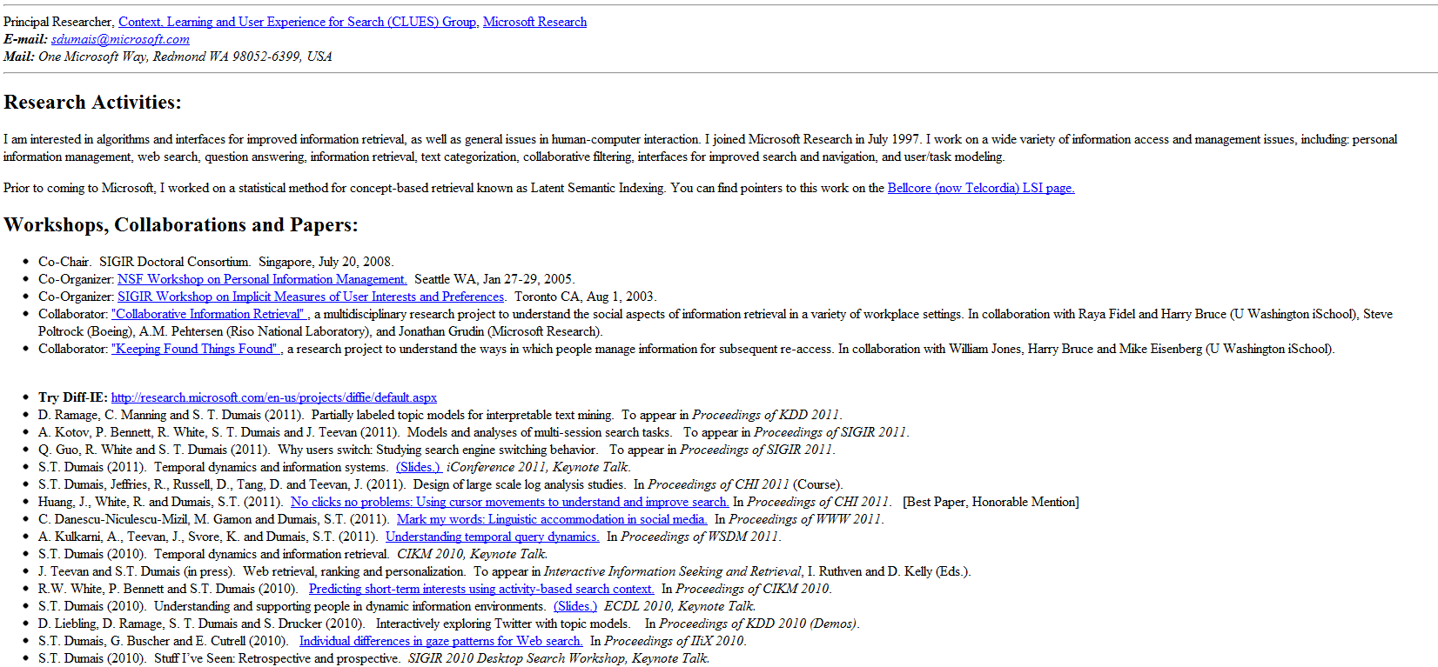
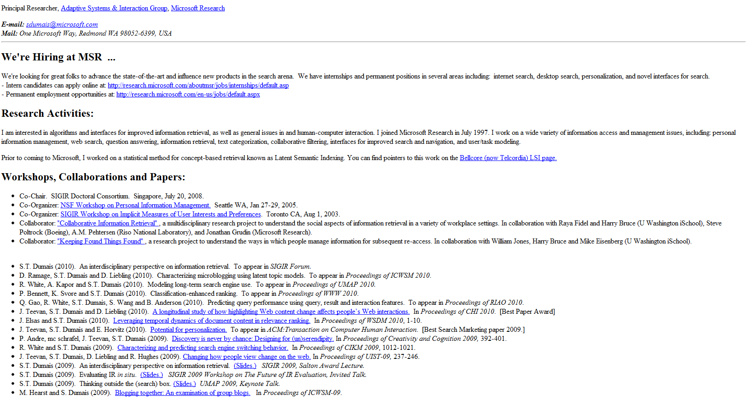
2009
2010
2011
Personal Site

Slide 5
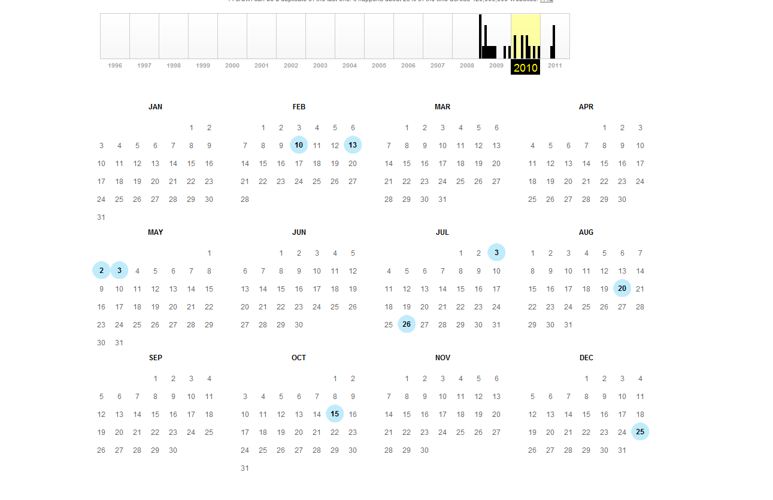

Slide 6
Unified Approach for
Content Change Prediction
1D Setting
use observation of change only
2D Setting
use observation of change and
content from the page itself only
3D Setting
use change and content from
page and related pages.

Slide 7

Results – what information to use?
  Content improves over Page Change Frequency alone
  Related pages improve over Content & Change frequency

Slide 8

Results – how to combine the information?
  Having different views of the change leads to best results

Slide 9
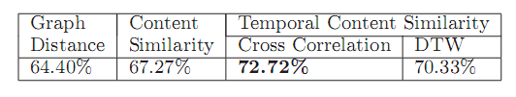

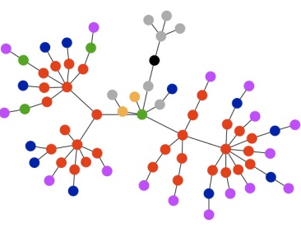
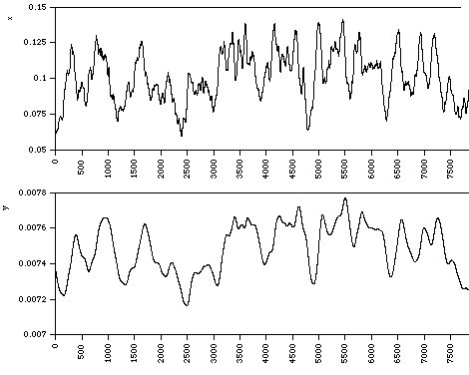
Results – how to choose the related pages?
  Best indicators of page change are the correlations in content similarity over time.
Notes:
An example where related page expert selection outper-
forms the 1D and 2D approaches is for the URL http://
www.thekirkreport.com/archives.html. This is a URL irregu-
larly giving updates on stock trading. The content similarity
KNN method (Section 6.2) chose the page of the American
ﬁrst credit union http://www.amerfirst.org/, that provides
updates on rates, credits and loans. And indeed, in many
of the times that the kirkreport had changes, it followed a
signiﬁcant update of all the rates on the amerﬁrst site

Slide 10
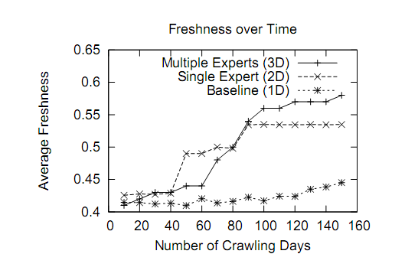
How Can it Improve Crawling?

Slide 11
Conclusions
Page content is useful for identifying page change
Related pages content also helps in deciding which pages will change
The combination of the data is important, and can be efficiently distributed
Applications
  Improved incremental crawling strategy.
  Prediction of a new hyper-link to a previously unknown (i.e., non-indexed) web page.
  Personalized new content RSS

