Slide 1
Modeling and Predicting Behavioral Dynamics on the Web
Kira Radinsky (Technion, Israel)
Krysta Svore (Microsoft Research)
Susan Dumais (Microsoft Research)
Jaime Teevan (Microsoft Research)
Alex Bocharov (Microsoft Research)
Eric Horvitz (Microsoft Research)

Slide 2
Motivation
Query Frequency Changes over Time
February 14th
Notes:
We see query frequency is very time dependent
Let’s zoom in on one of the days.
It is taken from a real online suggestion system.
This is being done on valentine’s day

Slide 3
Motivation
Query Intent Changes over Time

Slide 4
What If We Could Predict…
Query Click Behavior?
  Better Query Auto suggestion
Query-URL Click Behavior?
  Better Ranking
URL Click Behavior?
  Focused Crawling
Notes:
Query click frequency each day:
Query click frequency over time, i.e., how much people click on a results for this query each day
Query URL click frequency each day:
Conditioned on the query, how much people clicked on this url on a certain day
URL click frequency each day

Slide 5
Solution Outline
Model
  Model behavior as a time series
  Assume semi-linear state space modeling
Learn Structure and Parameters
Predict Y
The prediction for time t
Error at time t
State vector a time t
(inc. last point, trend, etc.)
Notes:
In control engineering, a state space representation is a mathematical model of a physical system as a set of input, output and state variables related by first-order differential equations.
To abstract from the number of inputs, outputs and states, the variables are expressed as vectors. Additionally, if the dynamical system is linear and time invariant, the differential and algebraic equations may be written in matrix form. The state space representation (also known as the "time-domain approach") provides a convenient and compact way to model and analyze systems with multiple inputs and outputs. Unlike the frequency domain approach, the use of the state space representation is not limited to systems with linear components and zero initial conditions. "State space" refers to the space whose axes are the state variables. The state of the system can be represented as a vector within that space.
Model
Learn
Predict: Jointly learn Y₁…Y_{n} with internal states X₁…X_{n} and residuals e₁…e_{n}
Generate “future states” X_{n+1}…X_{n+h} using the state transition equations
Using the new states calculate the distribution for future values Y_{n+1}…Y_{n=h}
We learn an SSM for time series y_1…y_n along with internal states x0…xn
Now generate “future states” x_(n+1),…,x_(n+h-1) using the state transition equation,
And from these “future values” y_(n+1),…, y_(n+h) using the measurement equation.
This is point forecast for the time series given SSM.
Again, the forecast distributions can be parametric or non-parametric. When mean of epsilon is zero, the mean for each forecast distribution coincides with the corresponding point forecast (defined earlier). Our time series toolkit currently supports Gaussian and Nonparametric long-range forecasts.

Slide 6
Solution Outline
Model
  Model behavior as a time series
  Assume semi-linear state space modeling
Learn Structure and Parameters
Predict Y
The prediction for time t
Error at time t
State vector a time t
(inc. last point, trend, etc.)

Slide 7
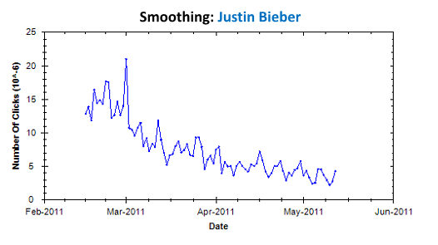
Modeling with Smoothing
Average
Smoothing

Slide 8
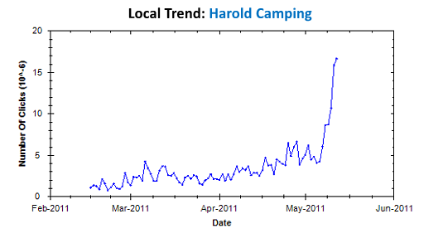
Modeling with Trend
Trend
Average

Slide 9
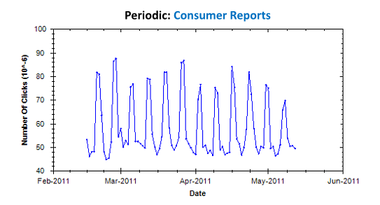
Modeling with Periodicity
Average
Periodic

Slide 10
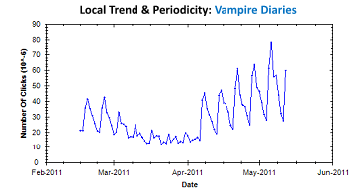
Modeling with
Trend & Periodicity
Notes:
And we can actually combine the previous two

Slide 11
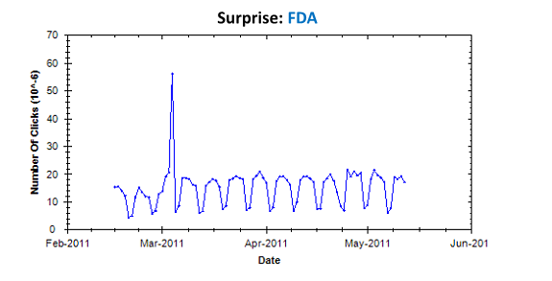
Modeling with Surprise

Slide 12
Solution Outline
Model
  Model behavior as a time series
  Assume semi-linear state space modeling
Learn Structure and Parameters
Predict Y
The prediction for time t
Error at time t
State vector a time t
(inc. last point, trend, etc.)
Notes:
Model
Learn
Predict: Jointly learn Y₁…Y_{n} with internal states X₁…X_{n} and residuals e₁…e_{n}
Generate “future states” X_{n+1}…X_{n+h} using the state transition equations
Using the new states calculate the distribution for future values Y_{n+1}…Y_{n=h}
We learn an SSM for time series y_1…y_n along with internal states x0…xn
Now generate “future states” x_(n+1),…,x_(n+h-1) using the state transition equation,
And from these “future values” y_(n+1),…, y_(n+h) using the measurement equation.
This is point forecast for the time series given SSM.
Again, the forecast distributions can be parametric or non-parametric. When mean of epsilon is zero, the mean for each forecast distribution coincides with the corresponding point forecast (defined earlier). Our time series toolkit currently supports Gaussian and Nonparametric long-range forecasts.

Slide 13
Base Learning Structure
Train
Test
Train models
Evaluate Precision
(using BIC)
Notes:
We can employ training data to select the best predictive
model. A common practice in model selection is to optimize
the Bayesian information criterion (BIC), where q is the number of parameters, n is the length of the time series, and σe [For a Gaussian likelihood]
is the variance of the residual in the testing period (estimated from the test data).
The model with the lowest BIC is selected to represent the
time series and to issue point forecasts.

Slide 14


DML Learning Structure
  Specific Models:
  Generalized Models:
  Combining Specific and Generalized (DML):
Notes:
Adding group features for regression prediction:
Correlation between query and query-url
Window features
Features of sets: are they in the same cluster, how they correlate etc, have a new one correlated etc...
Temporal features: size of spikes, is there a huge spike, sharpness (when going up, when going down)
How many times the urls switch ranking

Slide 15
DML Example Model
Notes:
Aggregate Features. Features such as the average,
minimum, maximum, and period of the time series, number of surprises, size of spikes
Shape Features
Shape features represent the shape of the time series. Our goal is to produce a representation that is not sensitive to shifts in time or the magnitude of the differences.
In speech recognition: Homomorphic signal processing is a solution that satisfies these conditions
1 FFT operator application transforms to spectral domain (each cell is a frequency of the time series) .
This eliminates shifts
Another application of FFT produces quefrencies
And The second part eliminatesdifferences in sizes
Domain-Specific Features:
number of clicked URLs, query click entropy, topical distribution of the URL or query

Slide 16
Learning Parameters: Periodicity
Notes:
We found that just applying auto correlation does not work well, but we therefore limit to standard seasonality in the web

Slide 17
Learning Parameters: Surprises
Actual
Predicted
Surprises are significant changes in the residual
Only long impact events should be considered
We define Impact: MSE of the model on the times after the event
Greedily select events to skip during learning as long
as MSE decreases
Notes:
In the beginning of a spike the model “under-predicts” the data since the previous data did not include any indication of a spike.
Surprises are significant changes in the residual during the period of an event.
Only surprises that have long impact on the model should be considered as a surprise. We propose a greedy procedure that adds the surprise locations starting from highest to lowest impact to the model and measures the improvement of the model (using BIC criteria).

Slide 18
Real-World Data
Query Class | Size
General | 10000 queries 35,862 URLs 6 months of data
Dynamic | 504 queries 1512 URLs 6 months of data
Temporal Reformulation | 330 queries 1320 URLs 6 months of data
Alternating | 1836 queries 7344 URLs 6 months of data
Notes:
Normalized by rank and impression
Only top n urls are considered
Only urls with enough click data
1. General queries: General queries randomly sampled (unique on a given day)
2. Dynamic Queries: Queries labeled as requiring fresh results
3. Temporal-Reformulation Queries : Queries reformulated with temporal word added
4. Alternating Queries : Randomly sampled queries whose URLs change rankings

Slide 19
Baseline Methods
Baseline | Description
Average
Linear Weighting
Power Weighting
Yesterday | What happened yesterday is what will happen tomorrow
Notes:
Averaged over several prediction days

Slide 20
Temporal SSM Results
*Prediction Errors. The smaller the number the better the prediction.
Temporal Models Outperform Static Models

Slide 21
Temporal SSM Results
Query Prediction
URL Prediction
Query-URL Prediction
Best Temporal Model Depends on Query Type

Slide 22
DML Results
Query Prediction
URL Prediction
Query-URL Prediction
DML Outperforms Best Temporal Models

Slide 23
Summary
Temporal models outperform static models in general
Temporal models performance varies for different query types
Smoothing surprises boosts performance (when behavior is rife with disturbances)
Dynamic and Alternating queries benefit from trend modeling
DML model selection paves the way to incorporate several temporal models with high accuracy
Many applications: time-aware ranking, time-aware query suggestion…

Slide 24
Thank you!
References
Full set of features used for the DML www.technion.ac.il/~kirar/Datasets.html
Questions, email Kira
kirar@cs.technion.ac.il

Slide 26
Seasonality Detection Results

Slide 27
Surprise Detection Results

